Slide 1

Claude AI Excel Masterclass

Slide 2

Data Cleaning

Slide 3

Prompt #1
Analyze this dataset and provide key KPIs, trends, insights, and suggested charts, and key points to improve/focus, generate report in New sheet and do not overlap reports

Slide 4

Prompt #2
Identify the salesman who generate maximum profit

Slide 5

Prompt #3
Explain effective strategies to grow sales in the future, including customer understanding, digital marketing, product improvement, and market trend analysis. Provide practical and actionable insights in a professional tone.

Slide 6

Prompt #4
Please provide month wise sales in waterfall chart.

Slide 7

Prompt #5
What will be the future sales trend?

Slide 8

Prompt #6
Product wise monthly trends

Slide 9
Prompt #7
How to analyse why the sales are less in certain territory, and Strategies to improve the sales for the area where the sales are less

Slide 10

Prompt #8
Identify products with most profits, between zones and current market product trend ?

Slide 11
Dashboard Creation

Slide 12
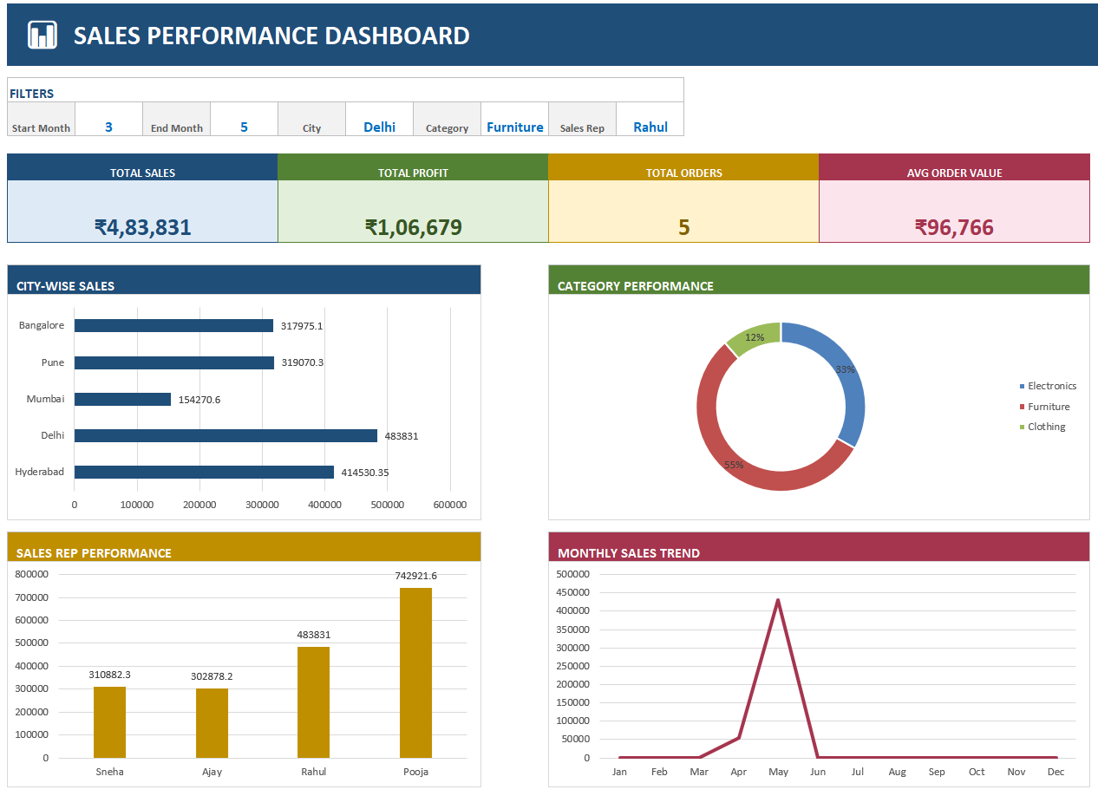

Slide 13
Append Data

